Slide 1
Lesson 1: Database essentials
KS4 - Databases and SQL
Notes:
Last updated: 17-06-21
Resources are updated regularly — the latest version is available at: ncce.io/tcc.
This resource is licensed under the Open Government Licence, version 3. For more information on this licence, see ncce.io/ogl.
This resource is licensed under the Open Government Licence, version 3. For more information on this licence, see ncce.io/ogl.

Slide 2
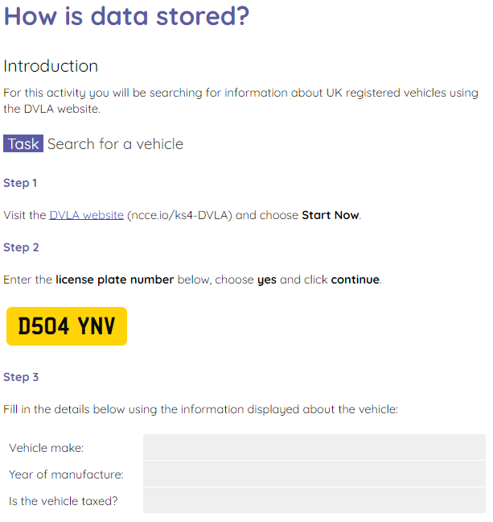
How is data stored?
Starter activity
Use the Activity 0 worksheet to search for vehicle information on the DVLA website.
Be prepared to comment on your answers to the final task.

Slide 3
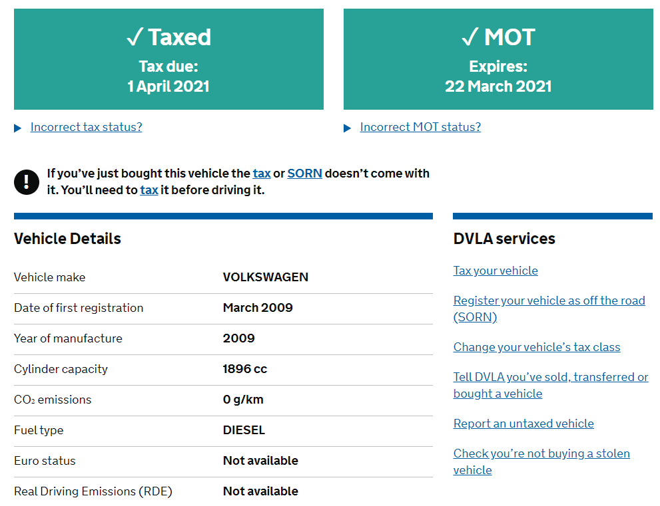
How is data stored?
Starter activity
Question .
How do you think the vehicle data has been stored?
In a database?
In a table?
In a structure that is easy to search?

Slide 4
How is data stored?
Starter activity
Question .
How many vehicles do you think the DVLA might have in their records?
Every registered car in the country?
Millions?
37.9 million

Slide 5
How is data stored?
Starter activity
When large amounts of data need to be collected and organised it is often stored in a database.
A database is a structured set of data. It is structured in tables that are easy to search and update.

Slide 6
How is data stored?
Starter activity
Here you can see a single record from a database.
A record is a collection of data for one object, person or thing.
In this case it is a record for a vehicle.

Slide 7
How is data stored?
Starter activity
Fields are used in a database to provide category headings for each piece of data in the database.

Slide 8

Lesson 1: Database essentials
Objectives
In this lesson, you will:
Describe a database
Define database key terms (table, record, field, primary key, foreign key)
Describe a flat file database
Describe a relational database

Slide 9
Database key terms
Activity 1
Here is a flat file database. A flat file database is a database that contains a single table.
tblTracks
TrackID | Title | Artist | Genre
1 | Float away | The Springs | Pop
2 | In denial | Rocketts | Rock
3 | With you | Funzo | Pop
4 | Us | The Feast | RnB
🔑

Slide 10
Database key terms
Activity 1
A table holds a collection of records for a particular theme.
In this case it is a collection of music tracks.
tblTracks
TrackID | Title | Artist | Genre
1 | Float away | The Springs | Pop
2 | In denial | Rocketts | Rock
3 | With you | Funzo | Pop
4 | Us | The Feast | RnB
🔑

Slide 11
Database key terms
Activity 1
The naming convention for a table always begins with a lowercase tbl followed by the name of the table.
tblTracks
TrackID | Title | Artist | Genre
1 | Float away | The Springs | Pop
2 | In denial | Rocketts | Rock
3 | With you | Funzo | Pop
4 | Us | The Feast | RnB
🔑

Slide 12
Database key terms
Activity 1
A table contains a collection of records.
Each record contains the data for one object, person, or place.
In this example, each record is a single song track.
tblTracks
TrackID | Title | Artist | Genre
1 | Float away | The Springs | Pop
2 | In denial | Rocketts | Rock
3 | With you | Funzo | Pop
4 | Us | The Feast | RnB
🔑

Slide 13
Database key terms
Activity 1
Fields
A table has a number of fields. These are the categories for each piece of data in the table.
This table has four fields.
TrackID
Title
Artist
Genre
TrackID | Title | Artist | Genre
1 | Float away | The Springs | Pop
2 | In denial | Rocketts | Rock
3 | With you | Funzo | Pop
4 | Us | The Feast | RnB
🔑

Slide 14
Database key terms
Activity 1
Each record in the table needs a unique identifier.
A primary key is used to give each record a unique code.
tblTracks
TrackID | Title | Artist | Genre
1 | Float away | The Springs | Pop
2 | In denial | Rocketts | Rock
3 | With you | Funzo | Pop
4 | Us | The Feast | RnB
🔑

Slide 15
Database key terms
Activity 1
A primary key can never be repeated.
This ensures that each record in the table is unique. This is very important when dealing with thousands or even millions of records.
tblTracks
TrackID | Title | Artist | Genre
1 | Float away | The Springs | Pop
2 | In denial | Rocketts | Rock
3 | With you | Funzo | Pop
4 | Us | The Feast | RnB
🔑

Slide 16
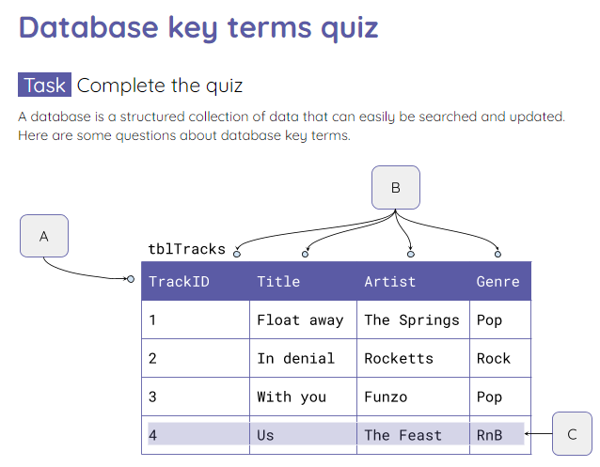
Database key terms
Activity 1
Complete the A1 Worksheet which is a quick quiz on the database key terms.

Slide 17
An inefficient flat file database
Activity 2
TrackID | Title | Artist | Genre | DloadID | Date | Time | MemberID | Firstname | Surname
1 | Float away | The Springs | Pop | 1 | 4.6.10 | 18:36 | 1 | Sara | Bibi
2 | In denial | Rocketts | Rock | 2 | 5.6.11 | 19:20 | 1 | Sara | Bibi
1 | Float away | The Springs | Pop | 3 | 9.6.12 | 09:30 | 2 | Danny | Judd
2 | In denial | Rocketts | Rock | 4 | 1.7.14 | 08:28 | 2 | Danny | Judd
1 | Float away | The spings | Pop | 5 | 9.1.11 | 03:45 | 3 | Cara | Lichfield
Here is a flat file database that has been used to record data about the downloads of tracks from a music website.

Slide 18
An inefficient flat file database
Activity 2
TrackID | Title | Artist | Genre | DloadID | Date | Time | MemberID | Firstname | Surname
1 | Float away | The Springs | Pop | 1 | 4.6.10 | 18:36 | 1 | Sara | Bibi
2 | In denial | Rocketts | Rock | 2 | 5.6.11 | 19:20 | 1 | Sara | Bibi
1 | Float away | The Springs | Pop | 3 | 9.6.12 | 09:30 | 2 | Danny | Judd
2 | In denial | Rocketts | Rock | 4 | 1.7.14 | 08:28 | 2 | Danny | Judd
1 | Float away | The spings | Pop | 5 | 9.1.11 | 03:45 | 3 | Cara | Lichfield
Activity .
Use the Activity 2 worksheet to highlight any potential issues that might arise from storing the data in this way.

Slide 19
An inefficient flat file database
Activity 2
TrackID | Title | Artist | Genre | DloadID | Date | Time | MemberID | Firstname | Surname
1 | Float away | The Springs | Pop | 1 | 4.6.10 | 18:36 | 1 | Sara | Bibi
2 | In denial | Rocketts | Rock | 2 | 5.6.11 | 19:20 | 1 | Sara | Bibi
1 | Float away | The Springs | Pop | 3 | 9.6.12 | 09:30 | 2 | Danny | Judd
2 | In denial | Rocketts | Rock | 4 | 1.7.14 | 08:28 | 2 | Danny | Judd
1 | Float away | The spings | Pop | 5 | 9.1.11 | 03:45 | 3 | Cara | Lichfield
Sara Bibi has downloaded two tracks. In a flat file database, her details would need to be entered twice. This is known as data redundancy.

Slide 20
An inefficient flat file database
Activity 2
TrackID | Title | Artist | Genre | DloadID | Date | Time | MemberID | Firstname | Surname
1 | Float away | The Springs | Pop | 1 | 4.6.10 | 18:36 | 1 | Sara | Bibi
2 | In denial | Rocketts | Rock | 2 | 5.6.11 | 19:20 | 1 | Sara | Bibi
1 | Float away | The Springs | Pop | 3 | 9.6.12 | 09:30 | 2 | Danny | Judd
2 | In denial | Rocketts | Rock | 4 | 1.7.14 | 08:28 | 2 | Danny | Judd
1 | Float away | The spings | Pop | 5 | 9.1.11 | 03:45 | 3 | Cara | Lichfield
The track ‘Float away’ has been downloaded three times. This means that all of this data would need to be entered three times. Another example of redundancy.

Slide 21
An inefficient flat file database
Activity 2
TrackID | Title | Artist | Genre | DloadID | Date | Time | MemberID | Firstname | Surname
1 | Float away | The Springs | Pop | 1 | 4.6.10 | 18:36 | 1 | Sara | Bibi
2 | In denial | Rocketts | Rock | 2 | 5.6.11 | 19:20 | 1 | Sara | Bibi
1 | Float away | The Springs | Pop | 3 | 9.6.12 | 09:30 | 2 | Danny | Judd
2 | In denial | Rocketts | Rock | 4 | 1.7.14 | 08:28 | 2 | Danny | Judd
1 | Float away | The spings | Pop | 5 | 9.1.11 | 03:45 | 3 | Cara | Lichfield
Having to enter data multiple times means the database is at an increased risk of having inaccurate data.

Slide 22
An inefficient flat file database
Activity 2
TrackID | Title | Artist | Genre | DloadID | Date | Time | MemberID | Firstname | Surname
1 | Float away | The Springs | Pop | 1 | 4.6.10 | 18:36 | 1 | Sara | Bibi
2 | In denial | Rocketts | Rock | 2 | 5.6.11 | 19:20 | 1 | Sara | Bibi
1 | Float away | The Springs | Pop | 3 | 9.6.12 | 09:30 | 2 | Danny | Judd
2 | In denial | Rocketts | Rock | 4 | 1.7.14 | 08:28 | 2 | Danny | Judd
1 | Float away | The spings | Pop | 5 | 9.1.11 | 03:45 | 3 | Cara | Lichfield
It also makes it much harder to update because you would need to change every occurrence of the data item. This can lead to inconsistent data.

Slide 23
Relational databases
Activity 2
The most common model for a database is a relational model.
A relational database contains more than one table.
The data in the tables are linked using relationships.

Slide 24
Relational databases
Activity 2
Relationships can be:
One to one
One to many
Many to many

Slide 25
Relational databases
Activity 2
A one to one relationship means that one record in a table relates to a single record in another table.

Slide 26
Relational databases
Activity 2
A one to many relationship means that one record in a table relates to multiple records in another table.

Slide 27
Relational databases
Activity 2
A many to many relationship means that multiple records in a table relate to multiple records in another table.

Slide 28
Relational databases
Activity 2
The downloads database needs to be stored in a relational database.
tblTracks
tblDownloads
tblMembers
TrackID
Title
Artist
Genre
DownlID
TrackID
MemberID
Date
Time
MemberID
Firstname
Surname
Email
Password

Slide 29
Relational databases
Activity 2
Keeping the database as a flat file database would cause issues with inconsistency and data redundancy.
tblTracks
tblDownloads
tblMembers
TrackID
Title
Artist
Genre
DownlID
TrackID
MemberID
Date
Time
MemberID
Firstname
Surname
Email
Password

Slide 30
Relational databases
Activity 2
This is because each track can be downloaded multiple times.
tblTracks
tblDownloads
tblMembers
TrackID
Title
Artist
Genre
DownlID
TrackID
MemberID
Date
Time
MemberID
Firstname
Surname
Email
Password

Slide 31
Relational databases
Activity 2
And each member can have have multiple downloads of different tracks.
tblTracks
tblDownloads
tblMembers
TrackID
Title
Artist
Genre
DownlID
TrackID
MemberID
Date
Time
MemberID
Firstname
Surname
Email
Password

Slide 32
Relational databases
Activity 2
Question .
What relationships are being formed here?
One to one
One to many
Many to many
tblTracks
tblDownloads
tblMembers
TrackID
Title
Artist
Genre
DownlID
TrackID
MemberID
Date
Time
MemberID
Firstname
Surname
Email
Password

Slide 33
Relational databases
Activity 2
Question .
What relationships are being formed here?
One to one
One to many
Many to many
tblTracks
tblDownloads
tblMembers
TrackID
Title
Artist
Genre
DownlID
TrackID
MemberID
Date
Time
MemberID
Firstname
Surname
Email
Password

Slide 34
Relational databases
Activity 2
The other benefit of a relational database is that all data can be updated at the original source.
tblTracks
tblDownloads
tblMembers
TrackID
Title
Artist
Genre
DownlID
TrackID
MemberID
Date
Time
MemberID
Firstname
Surname
Email
Password

Slide 35
Relational databases
Activity 2
Data doesn’t need to be repeated and relationships can be made using the source table’s unique identifier.
tblDownloads
DownlID | TrackID | MemberID | Date | Time
1 | 1 | 1 | 1.5.18 | 03:40
2 | 2 | 1 | 2.9.20 | 08:29
3 | 2 | 2 | 3.4.20 | 11:25
4 | 3 | 2 | 1.8.19 | 13:45
🔑

Slide 36
Relational databases
Activity 2
A primary key is unique to the original source of the data.
It cannot be repeated.
tblDownloads
DownlID | TrackID | MemberID | Date | Time
1 | 1 | 1 | 1.5.18 | 03:40
2 | 2 | 1 | 2.9.20 | 08:29
3 | 2 | 2 | 3.4.20 | 11:25
4 | 3 | 2 | 1.8.19 | 13:45
🔑

Slide 37
Relational databases
Activity 2
When you link to a source table’s primary key you use a foreign key.
tblDownloads
DownlID | TrackID | MemberID | Date | Time
1 | 1 | 1 | 1.5.18 | 03:40
2 | 2 | 1 | 2.9.20 | 08:29
3 | 2 | 2 | 3.4.20 | 11:25
4 | 3 | 2 | 1.8.19 | 13:45
🔑

Slide 38
Relational databases
Activity 2
A foreign key can be repeated because it is a link back to the primary key in the source table.
tblDownloads
DownlID | TrackID | MemberID | Date | Time
1 | 1 | 1 | 1.5.18 | 03:40
2 | 2 | 1 | 2.9.20 | 08:29
3 | 2 | 2 | 3.4.20 | 11:25
4 | 3 | 2 | 1.8.19 | 13:45
🔑

Slide 39
Relational databases
Activity 2
Using the foreign key you can go to the tblTracks table and find the linked track.
tblDownloads
DownlID | TrackID | MemberID | Date | Time
1 | 1 | 1 | 1.5.18 | 03:40
2 | 2 | 1 | 2.9.20 | 08:29
3 | 2 | 2 | 3.4.20 | 11:25
4 | 3 | 2 | 1.8.19 | 13:45
🔑

Slide 40
Relational databases
Activity 2
Using the foreign key you can go to the tblTracks table and find the linked track.
tblTracks
TrackID | Title | Artist | Genre
1 | Float away | The Springs | Pop
2 | In denial | Rocketts | Rock
3 | With you | Funzo | Pop
4 | Us | The Feast | RnB
🔑

Slide 41
Relational databases
Activity 2
You can also use the foreign key for the member to find out who downloaded that track at that time on that day.
tblDownloads
DownlID | TrackID | MemberID | Date | Time
1 | 1 | 1 | 1.5.18 | 03:40
2 | 2 | 1 | 2.9.20 | 08:29
3 | 2 | 2 | 3.4.20 | 11:25
4 | 3 | 2 | 1.8.19 | 13:45
🔑

Slide 42
Relational databases
Activity 2
You can also use the foreign key for the member to find out who downloaded that track at that time on that day.
tblMembers
MemberID | Firstname | Surname | Email | Password
1 | Sara | Bibi | s@b.com | 123456
2 | Danny | Judd | d@j.com | 987654
3 | Cara | Lichfield | c@l.com | qwerty
🔑

Slide 43
Relational databases
Activity 2
The music database now has three tables. All linked together using relationships.
Data isn’t repeated because it is linked to the source table’s primary key using the foreign key.
tblTracks
tblDownloads
tblMembers
TrackID
Title
Artist
Genre
DownlID
TrackID
MemberID
Date
Time
MemberID
Firstname
Surname
Email
Password
🔑
🔑
🔑

Slide 44
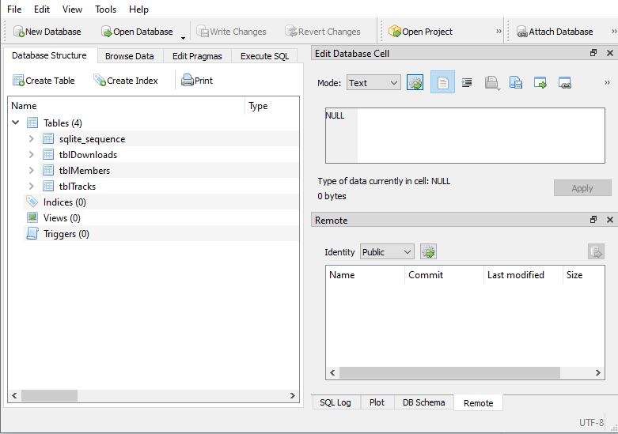
Using a database management system (DBMS)
Activity 3
You will be using DB Browser for SQLite as your database management system for this unit.
A DBMS allows you to define, manipulate, retrieve, and manage data in a database.

Slide 45

Using a database management system (DBMS)
Activity 3
Teacher demonstration

Slide 46
Using a database management system (DBMS)
Activity 3
Complete the Activity 3 worksheet which will allow you to explore the database and familiarise yourself with the new application.

Slide 47

What other data has been repeated?
Plenary
Take another look at the music database.
Questions Think, write, pair, share
Where can you still see repetition of data?
What could you do to reduce the repetition?
Notes:
Image source: https://pixabay.com/photos/bulb-light-idea-electricity-energy-5258341/

Slide 48
What other data has been repeated?
Plenary
Take another look at the music database.
Answers Think, write, pair, share
Where can you still see repetition of data?
Genre and Artist are repeated in the tracks table.
Notes:
Image source: https://pixabay.com/photos/bulb-light-idea-electricity-energy-5258341/

Slide 49
What other data has been repeated?
Plenary
Take another look at the music database.
Answers Think, write, pair, share
What could you do to reduce the repetition?
You could have separate tables for genres and artists.
Notes:
Image source: https://pixabay.com/photos/bulb-light-idea-electricity-energy-5258341/

Slide 50
Next lesson
Summary
In this lesson, we…
Learnt about flat file and relational databases.
Learnt the key terms associated with databases.
Explored a database management system.
Next lesson, we will…
Learn how to retrieve data from a database using SQL code.

